Slide 1
Technology
at Central Lancaster High School

Slide 2
Technology at CLHS
The ‘why?’
Design and Technology GCSE (AQA)
Do you love creative thinking, problem solving, planning and manufacturing. Do you want to gather skills which could help shape the future?
Hospitality and Catering Level 1/2 (WJEC)
Do you have a love of food, health and nutrition and have an interest in the catering industry?
The desire and ability to think creatively and consider other peoples perspectives.

Slide 3
Hospitality and Catering
Exam Board and Method of assessment
Unit 1: Assessment
External assessment (Examination) 40% of final grade.
Unit 1 enables learners to gain and develop comprehensive knowledge and understanding of the hospitality and catering industry including provision, health and safety, and food safety.
One 80 minute examination.
Unit 1 The Hospitality and Catering Industry
Unit 2 Hospitality and Catering in Action
Unit 2: Assessment
Internally assessed (Catering practical) 60% of final grade.
Unit 2 enables learners to develop and apply knowledge and understanding of the importance of nutrition and how to plan nutritious menus. They will learn the skills needed to prepare, cook and present dishes.
12 hour assessment over 4 sittings
Practical 3 ½ hours

Slide 4
Hospitality and Catering
Overview of course content
Unit 1: The Hospitality and Catering Industry.
This unit provides a broad introduction to the sector in a way that is purposeful and develops a range of transferable skills.
Pupils learn all aspects of the sector from types of establishment, to front of house operation, to delivery and storage. They acquire knowledge of all aspects of the industry and are able to propose new hospitality and catering provisions for specific locations. They explore different types of establishments and job roles within them to determine the best options for a new enterprise.
They learn, in detail, what front of house and kitchen operations entail on a day to day basis and are able to determine how the proposed hospitality and catering provision could operate efficiently.
Unit 2: Hospitality and Catering in Action
Pupils apply their learning to safely prepare, cook and present nutritional dishes.
They will draw on their learning of different types of provision and kitchen and front of house operations in Unit 1, as well as personal safety in their preparations.
The content is relevant not only to employees within food production, but also those with a responsibility for food safety in the industry, nutritionists and managers and owners.

Slide 5
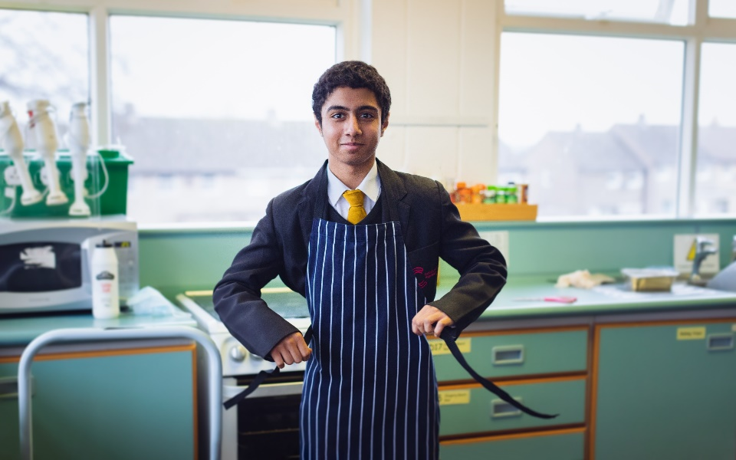
Hospitality and catering
Component unit 1
Understand the environment in which hospitality and catering providers operate.
Analyse job requirements within the hospitality and catering industry.
Understand the operation of the front and back of house.
Understand health and safety in hospitality and catering
Know how food can cause ill health.
Describe the role and responsibilities of the Environmental Health Officer (EHO).
Describe the symptoms of food induced ill health.

Slide 6
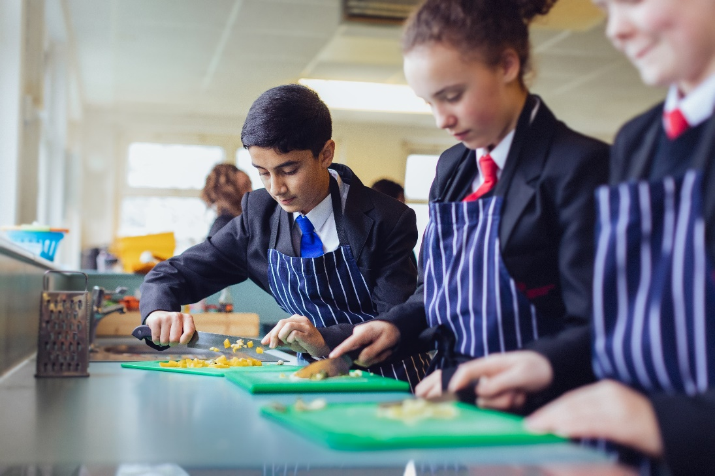
Hospitality and catering
Component unit 2
Understand the importance of nutrition when planning menus.
Explain characteristics of unsatisfactory nutritional intake.
Explain how cooking methods impact on nutritional value.
Explain how dishes on a menu address environmental issues.
Demonstrate skills and techniques for preparation, cooking and presentation of dishes
Evaluating cooking skills

Slide 7
Design and Technology
Exam board and method of assessment
NEA (non-exam assessment or coursework) is worth 50%
The exam makes up the remaining 50% and is 2 hours long
Testing you in 3 sections:
Section A – Multiple choice, short answers
Section B – A few short questions and a longer question
Section C – Short and Long questions
15% maths questions

Slide 8
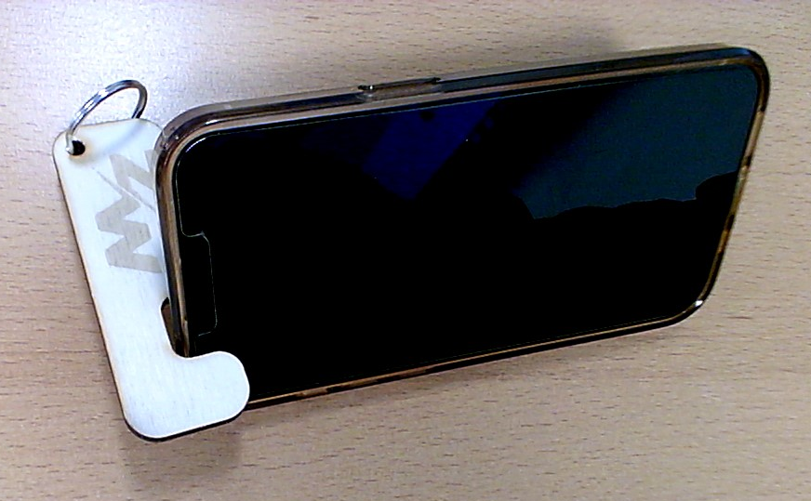
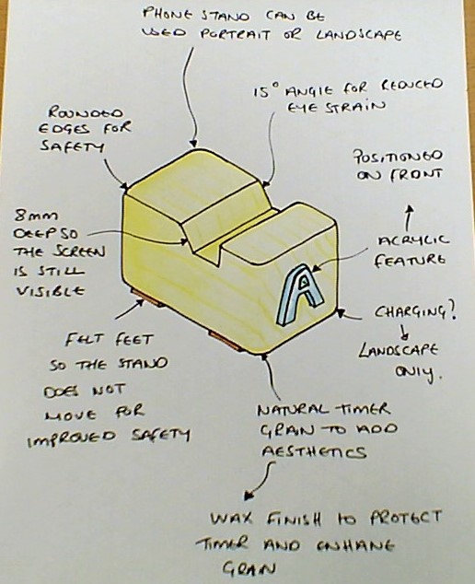
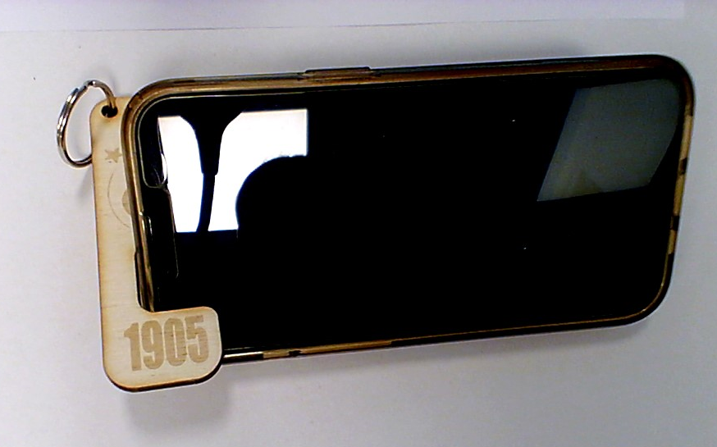
Year 10
Theory
Theory is done in exercise books and accompanied by worksheets and homework. Homework is given to enhance knowledge on each topic.
The theory lessons are taught alongside the practical tasks. Every topic could be covered in the exam, students require a broad knowledge of many topics!
5 hours over week A and B
Practical's = 2 lessons
Theory = 3 lessons
Mobile phone stand practical
Term 1 and 2 sees year 10 complete a project to design, make and evaluate phone stands from timber. Concept 1 is manufactured by hand , using hand tools. Concept 2 is designed and manufactured using 2D design (CAD) and the laser cutter (CAM). This allows students to compare between handmade and automated manufacture.
Mini NEA
Term 3 we begin a mock NEA. Students will be given a design scenario, and they need to develop a portfolio and prototype.

Slide 9
Students generate their initial ideas based on the previous steps. Designs must be creative and show design flair. This section is worth 20 marks towards the NEA.
Year 11
We move on to completing a design brief and design specification worth another 10 marks towards the NEA
Students complete 10 marks worth of research, primary and secondary.

Slide 10
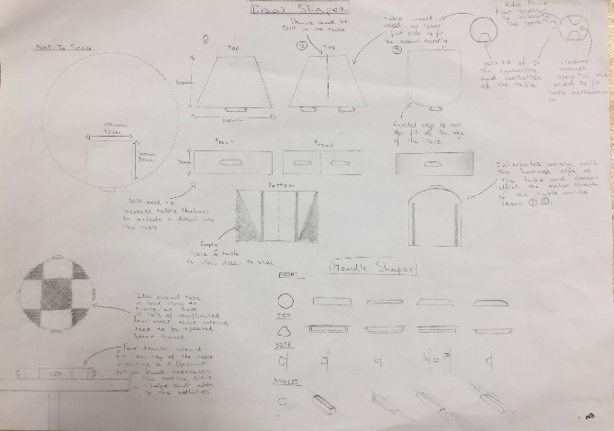
Finally, students evaluate their work against their specification. Casting judgement is an important part of the project. Worth the final 20 marks of the NEA.
Year 11
Students use various workshop tools and CAD/CAM to realise their developed designs, worth another 20 marks towards the NEA.
Students develop their initial ideas and make iterations, supported by a manufacturing specification. Designs must show good judgement on materials and processes. This section is worth 20 marks towards the NEA too.

Slide 11
Technology at CLHS
Where might it lead?
Design and Technology GCSE (AQA)
Architect
Civil engineer
Product design
Mechanical engineer
Carpenter
Construction manager
Fabrication
Electrician
Hospitality and Catering Level 1/2 (WJEC)
Food and nutrition
Waiting staff
Event manager
Food and beverage marketing
Hotel manager
Chef
Catering manager
Food production

Slide 13
For more information about the courses,
please speak to your child's technology teacher at progress evening on Thursday 14th March 2024.

