Slide 1
Sports Studies
at Central Lancaster High School

Slide 2
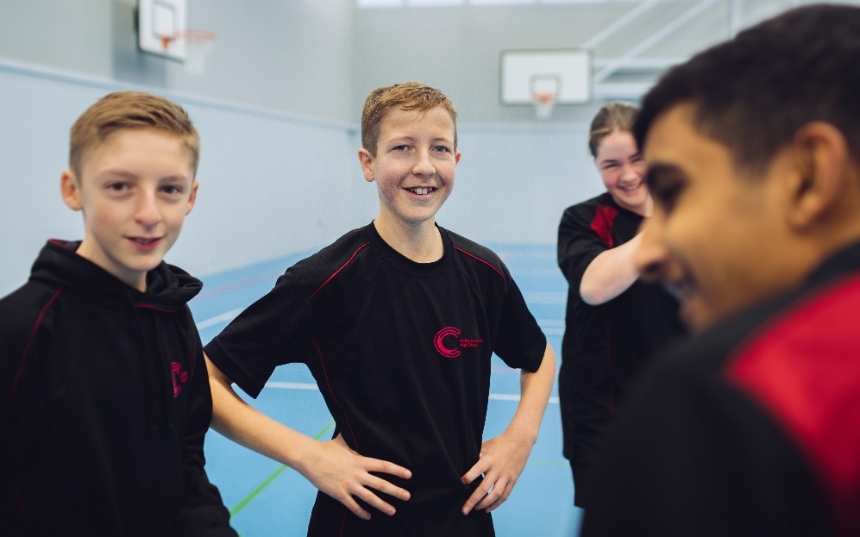
Why study Sports Studies(PE)?
For any pupil who enjoys playing and learning about the world of sport, PE is a must!
We combine theory classes with practical elements to ensure that pupils are well prepared for their assessments.
Pupils will play in both team and individual sports and get the chance to develop their coaching skills.
Pupils will play a variety of sports and learn about a vast array of different issues the world of sport is facing.

Slide 3
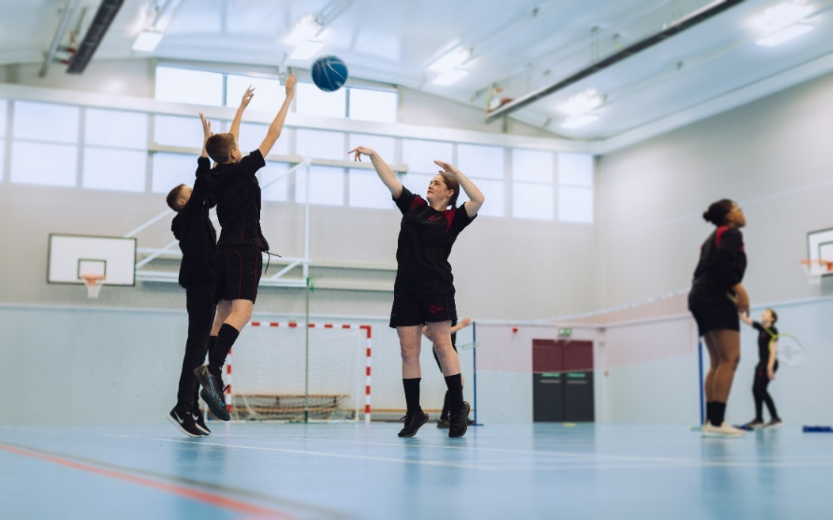
Exam Board and Assessment
The exam board is OCR and the qualification is called a Cambridge National (Sports Studies).The overall grade will be at Pass, Merit, Distinction or Distinction * at either level 1 or 2.
There are 3 units:
Unit 1: Assessed as an exam at the end of year 11.
Unit 2: A coursework based unit, chosen by the exam board, assessed by the school and moderated by the exam board.
Unit 3: A coursework based unit, chosen by the school, assessed by the school and moderated by the exam board.

Slide 4
Overview of course content

Slide 5
Contemporary Issues- Examined Unit- 40% of the course
By completing this unit pupils will understand a range of topical and contemporary issues in sport, including learning about participation levels and barriers to completing sporting activities.
They will also learn how participation is impacted by the promotion of values and ethical behaviour, about the role of high-profile sporting events, the role of national governing bodies and how technology is used in within sport.
Topics include:
Issues which affect participation in sport.
The role of sport in promoting values.
The implications of hosting a major sporting event for a city or country.
The role National Governing Bodies (NGBs) play in the development of their sport.
The use of technology in sport.

Slide 6
Performance and Leadership in Sports (assignment) 40%
In this unit pupils will have an opportunity to develop their skills both as a performer in two different sporting activities, and as a leader, developing a range of transferable skills.
Pupils will work both independently and as part of a team, including communicating with team mates as well as being in front of an audience when they perform.
They will perform under pressure, both as a participant and as a leader, and will use their initiative to solve problems and make decisions.
Finally, they will deal with rapidly changing conditions and situations.
Topics include:
Key components of performance
Applying practice methods to support improvement in a sporting activity
Organising and planning a sports activity session
Leading a sports activity session
Reviewing their own performance in planning and leading a sports activity session.

Slide 7
Media in Sports (set assignment) 20%
In this unit pupils will understand the different sides of a range of media sources and apply real life examples to show the nature of the relationship between media and sport.
They will also learn how rapid development in technology is enabling sport to be viewed, replayed and discussed whenever and wherever the spectator wants.
Pupils will then develop their ability to evaluate and interpret the different ways in which sport is represented by the media.
Topics include:
The different sources of media that cover sport
Positive effects of the media in sport
Negative effects of the media in sport.

Slide 8
Where can this qualification take you?

Slide 9
For more information about the course,
please speak to your child's PE teacher at progress evening on Thursday 14th March 2024.

