Slide 1
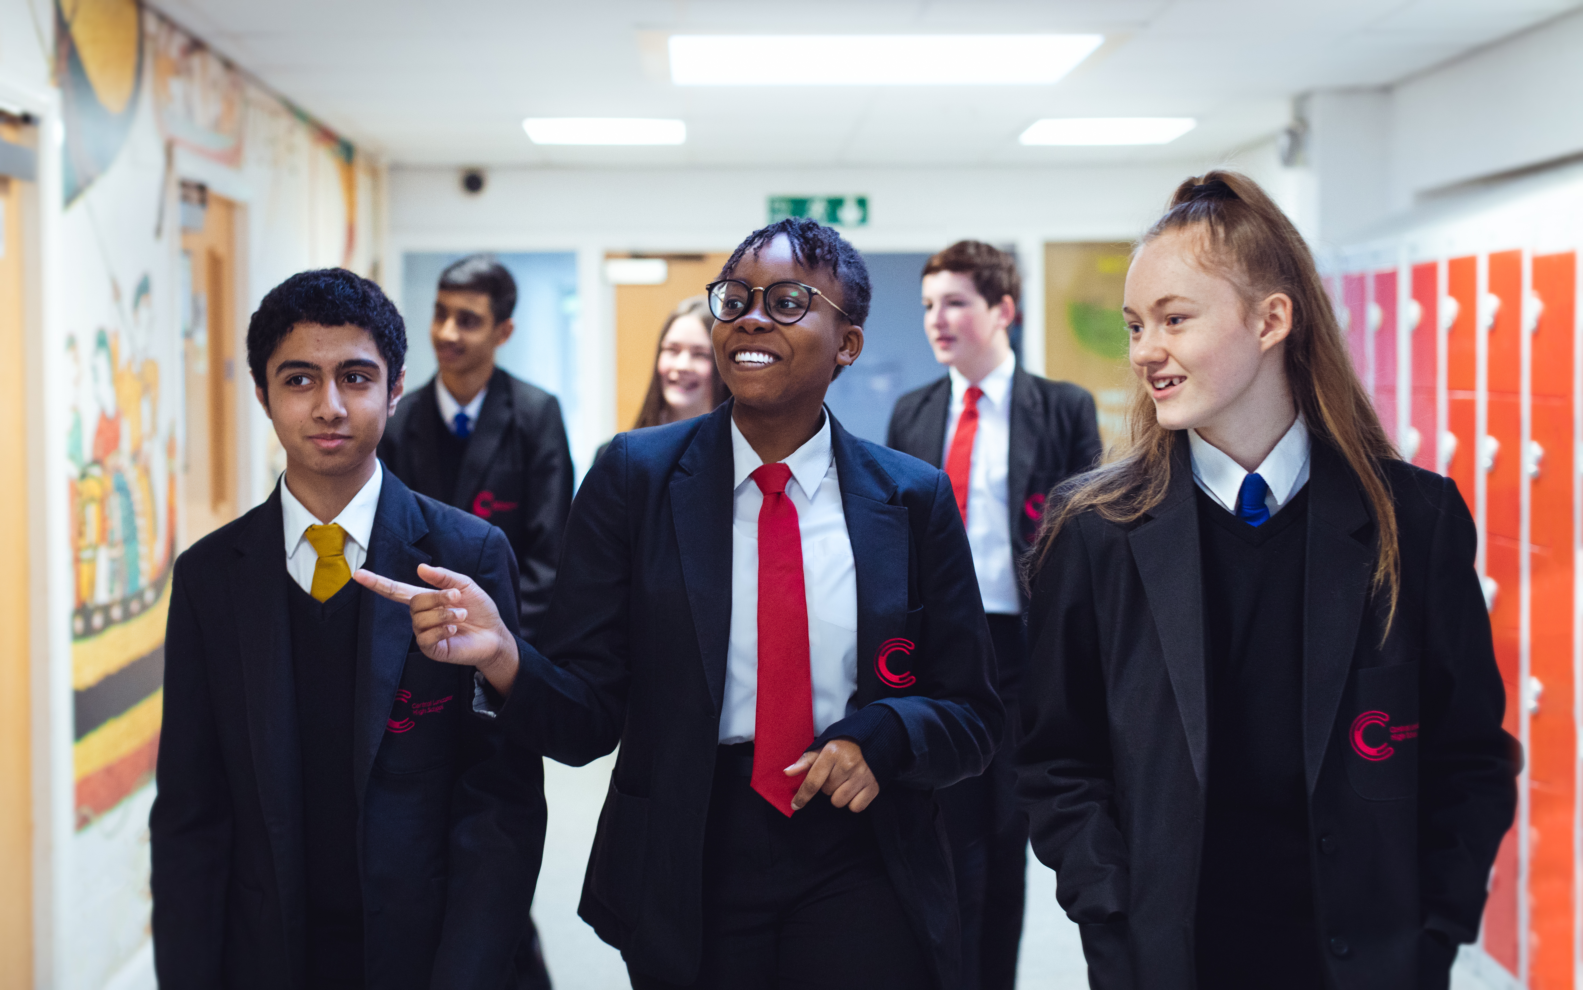
Options Information Evening 2024
Notes:
Welcome to our year 9 options information evening.
It's lovely to see you all here tonight at what is a very exciting stage of your child's education.
This evening we hope to provide you with the information you need to be able to make an informed choice about the subjects and qualifications your child would like to study for the next two years.

Slide 2
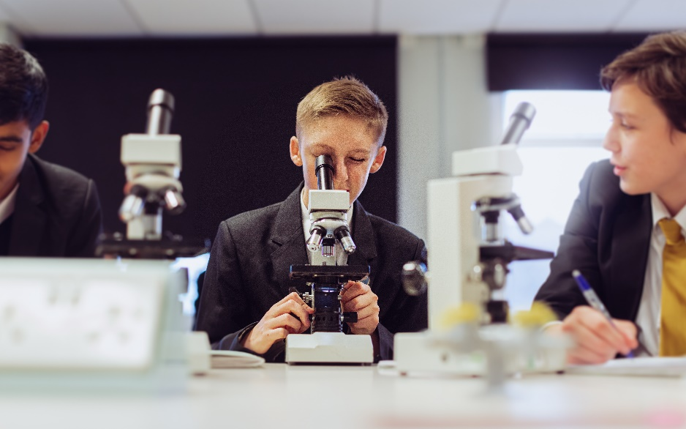
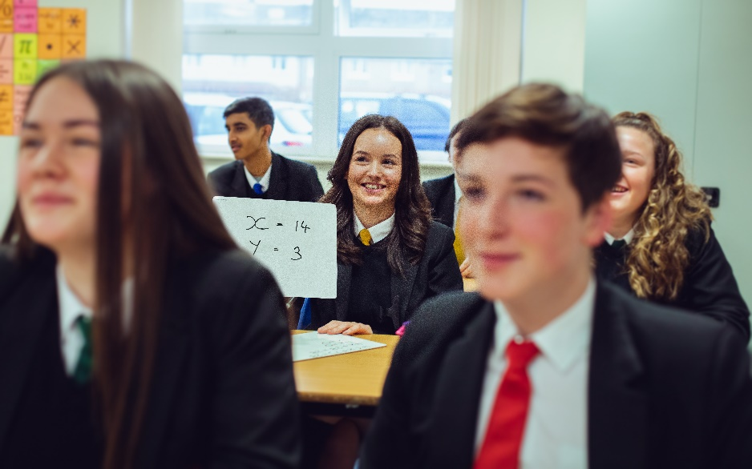
This can be a daunting time for pupils and parents. This evening is to help you to support your child in making well-informed choices.

Slide 3
What are the main differences between Key Stage 3 and Key Stage 4?
Pupils take fewer subjects and become more ‘specialist’ in the options they choose
There is more lesson time dedicated to each option subject
Homework increases and there is more need for pupils to take responsibility for their own learning
There are mock and final examinations in most subjects
The exam results from KS4 help pupils to move onto their next phase of education.

Slide 4
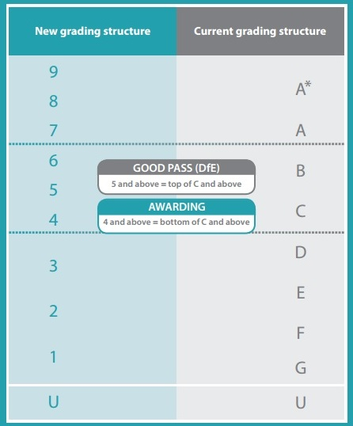
How are GCSEs graded?
Notes:
Although in school we are used to the new grading system for GCSE's, when you were at school you probably received grades in the form of letters.
This table gives you an ideas of the equivalent grades.
It is worth noting that all post 16 courses will ask for a good pass in English and Maths, or ask your child to continue to study maths and English until they are 18.

Slide 5
What is the EBacc?
The Ebacc is not a qualification in its own right, it is a suite of qualifications.
A child is considered to have achieved the EBacc if they have got ‘good passes’ (currently grade 4 or above) in English, maths, science, history or geography and a language.
At CLHS we offer the opportunity for pupils to take these subjects together and encourage them to experience a broad and balanced curriculum.
Should my child be taking the EBacc?
We encourage our pupils to take the EBacc it as offers a good basis to build on for later study, for example, the languages element helps to improve vocabulary, and sentence construction; reinforcing the literacy needed in English, history and geography. It also deepens an understanding of other cultures. Some of the top universities consider EBacc combinations when making offers, and employers understand these subjects and qualifications.

Slide 6
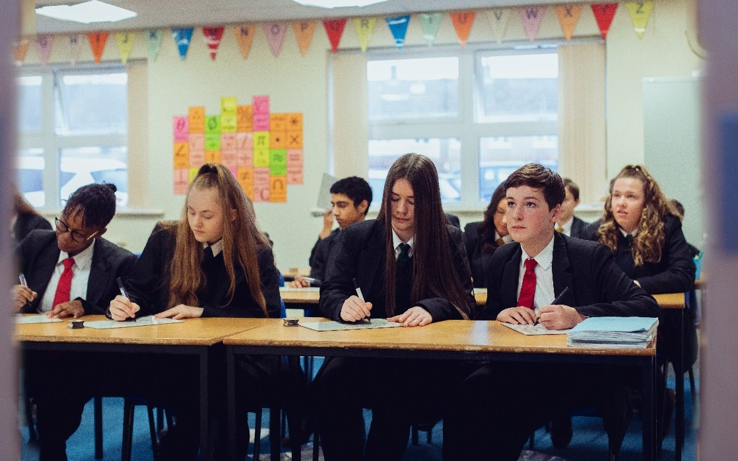
What are the compulsory subjects which pupils must study?
All pupils must study:
English literature and language (GCSE)
Mathematics (GCSE)
Science (GCSE) – either combined or triple
History and/or geography (GCSE), and/or French and/or Spanish – more than one can be taken
Core PE – not examined
Life lessons – not examined

Slide 7
What are the optional subjects?
Art and Design | GCSE
Business and Enterprise | Vocational
Creative iMedia (ICT) | Vocational
Design Technology | GCSE
French (do not choose this if you have selected it in section 1) | GCSE
Geography (do not choose this if you have selected it in section 1) | GCSE
History (do not choose this if you have selected it in section 1) | GCSE
Hospitality and Catering | Vocational
Music | GCSE
Religious Studies | GCSE
Spanish (do not choose this if you have selected it in section 1) | GCSE
Sports Studies | Vocational
Triple Science | GCSE
Final courses are subject to group sizes. So, while we endeavour to give 1st choices to ALL pupils, we ask you to indicate 2 reserve choices too.

Slide 8
How do I best support my child in making these decisions?
Talk to them about their future and what they would like to do as a career. Help them to research the qualifications needed to get into these jobs
If they don’t have a career aim, they should be aiming to get the best grades possible so discuss the subjects they enjoy studying. These are likely to be the ones they will achieve well in
Consider subjects which naturally work well together, such English, history and French, or business and ICT, or music and drama
Please discourage your child from taking a subject because their friends are taking it, or because they like the teacher
Explore a range of options, not all subjects may run as this is based on demand from pupils.

Slide 9
Notes:
You may have seen the short film which was playing as you entered the hall.
This provided you with an overview of the Labour Market for Lancaster and Morecambe.
In Lancashire we know that these 7 sectors are in high demand . This means if your child chooses qualifications which enable them to access a pathway to one of these sectors they are very likely to be able to access employment when they finish formal education.

Slide 10
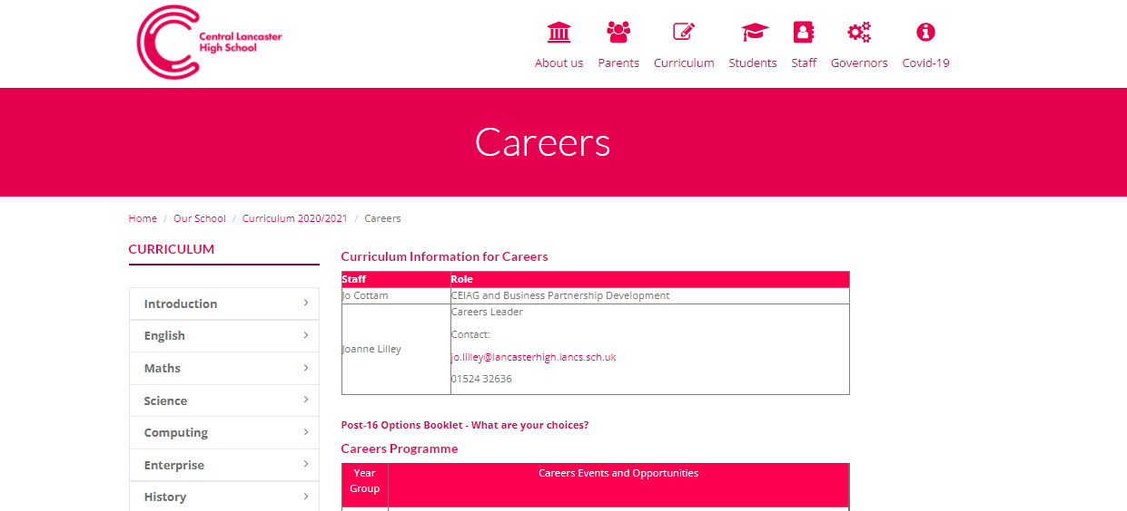
Further Information - School Website​
Notes:
Hopefully on your way in tonight you collected an Options booklet and an options form, this is also available on our school website.
We also link other resources which parents and carers can use to support their child regularly on our school newsletter, which Is emailed every week and also available on the school website.

Slide 11
Other support available tonight
Ms Mawdsley – Assistant SENDCO
Ms Morris – Head of Year 9
Notes:
Should you wish to talk to someone from our SEND department regarding the appropriate next steps for your child Ms Mawdsley andMrs Ainsworth will be available in the reception area.
You will also be able to talk to Mrs. Prestwood, head of year 9 who will also co-ordinate the collection of options forms over the next two weeks

Slide 12
Dates for your diary
Thursday 14 March: Year 9 Parents’ Evening on School Cloud 4:00pm to 7:00pm
This evening provides you with a final opportunity to discuss your child’s academic progress to date and ask any follow up questions regarding KS4 study.
Thursday 21 March: Deadline for options forms to be submitted by pupils.

Slide 13
Subject presentations – 6.20, 6.45, 7.10 and 7.35
Subject | Room
Art and Design | A1
French / Spanish | A3
Business and Enterprise / Creative iMedia | A4
Geography | A5
History | A11
Hospitality and Catering / Design Technology | A6
Music | A10
Religious Studies | A7
Sports Studies | A8
Triple Science | A9
Notes:
Bell will ring at 6.40, 7.05 and 7.30 o give a five minute warning for the start of the next presentation.
Triple science only available for the first two presentations.
This table is also on the last page of the options booklet for you to reference.

