Slide 1
GCSE Geography
at Central Lancaster High School

Slide 2
GCSE
GEOGRAPHY

Slide 3
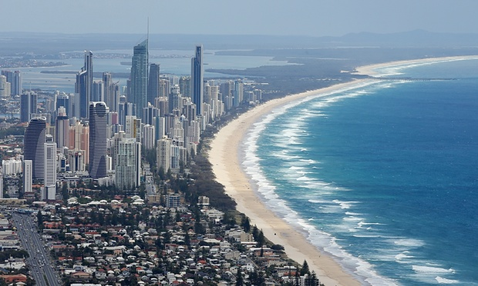
“Geography is all the rage.”
“Geography is a subject for our times.”
“Geography is soaring in popularity.”
Notes:
Geography is one of the most popular option choices at GCSE with over a third of pupils in England taking the subject. Geography is not only up-to-date and relevant, it is one of the most exciting, adventurous and valuable subjects to study at GCSE level. So important, in fact, that the Guardian newspaper in 2015 named Geography as a ‘must-have A-Level’ to help you make sense of the world.
Geography marries together the world of hard scientific fact and process, with human interaction and reaction, through skilful application. That is the strength. We don’t study for the sake of it, we problem solve. We don’t learn skills to sit in a room and stare at them, we go out and fix issues

Slide 4
debating and arguing your point
fieldwork
map skills
modern computer based mapping
interpreting photos, cartoons, diagrams…
working with data
statistics
digital technologies
convincing others you are right
critical analysis
decision making
analysing articles
investigating issues in the real world
report writing
empathy
boosting your memory
problem solving
a wide variety of
SKILLS
Notes:
Such a wide variety of skills gained in Geography will be useful after school. These skills are highly sought after by Sixth Form Colleges, universities and employers.

Slide 5
Skills developed through high quality
FIELDWORK

Slide 6
Skills
Notes:
These are the top 10 skills that many employers will look for in 2020. Geography covers all of these skills!
1. Complex problem solving – this is at the heart of Geography. Geography looks at problems and solutions
2. Critical thinking – for example, is climate change happening? Is Donald Trump right to ignore the evidence and allow more CO2 emissions? Are charities actually effective?
Creative solutions to problems, like vertical farming in the city, floating cities to avoid sea level rise, cars that run on hydrogen and clean energy
4&5. Working with others – group work, fieldwork and collecting data
6. Emotional intelligence – empathy with others, learning about different cultures
7. Judgement and Decision Making – Montserrat, should Cambourne West go ahead?
https://www.weforum.org/agenda/2016/01/the-10-skills-you-need-to-thrive-in-the-fourth-industrial-revolution/

Slide 7
Geography
OPENS DOORS
Geography is a facilitating subject along with Physics, Chem­istry, Biology, Maths and Further Maths, English, History and Clas­sical and Modern Lan­guages.
Notes:
“If you decide not to choose some of the facil­it­ating sub­jects at A Level, many degrees at com­pet­itive uni­ver­sities will not be open to you.”
Russell Group Universities – Informed Choices
LSE’s non-preferred subjects included: Art & Design, Business Studies, Drama, Media Studies, Law

Slide 8
Three examinations at the end of Year 11:
Unit 1 (1hr 30mins) tests Physical Geography (3 topics) 35% of final grade.
Unit 2 (1hr 30mins) tests Human Geography (3 topics) 35% of final grade.
Unit 3 (1hr 15mins) tests Fieldwork and contains a Decision Making Exercise. 30% of final grade
Notes:
We’ll do a lot of preparation for Unit - good for those of you who do not like exams! Twelve weeks before the Unit 3 examination, a resources booklet will be released. This booklet will contain information about a current and controversial geographical issue. The Unit 3 examination will be based on this issue. Before you go into the Unit 3 exam, you will have a strong idea about the content and possible questions that may come up.

Slide 9
What will
we study?

Slide 10
The Challenge of
NATURAL HAZARDS
Are earthquakes the deadliest natural hazard?
What if the UK was hit by a tsunami?
Notes:
You will learn about earthquakes, tsunami, hurricanes (how they’re caused, the effect on people and how people should respond)

Slide 11
What if all the world’s rainforests were cut down?
How do plants and animals survive here?
The Living
WORLD
Notes:
Rainforests and cold environments

Slide 12
Physical Landscapes
COASTS
What if all our cliffs collapsed?
How should we protect our coastlines?

Slide 13
What if all the world’s rivers dried up?
Why do people live near rivers that flood?
Physical Landscapes
RIVERS

Slide 14
What if no one migrated?
What if there was no countryside?
Urban Issues and
CHALLENGES
Notes:
You will learn about two of the most important cities in the world today – London (UK) and Rio de Janeiro (Brazil)

Slide 15
The Challenge of
RESOURCE MANAGEMENT
What if all power was renewable?
Are we running out of resources?

Slide 16
The Changing
ECONOMIC WORLD
What jobs will there be in the future?
How will new technology affect business and trade?
Notes:
Globalisation, business, jobs, technology, TNCs

Slide 17
Year 11
FIELDWORK
Notes:
…using the latest in digital technology.

Slide 18
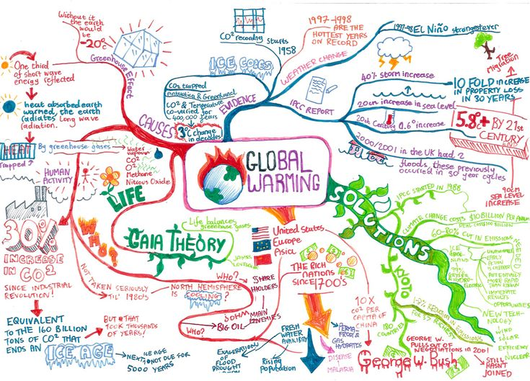
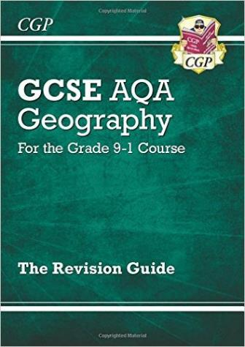
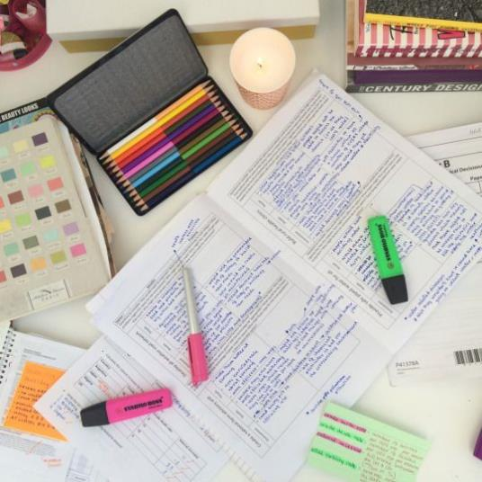
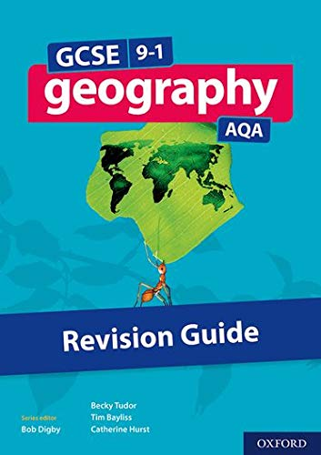
Notes:
Regular quizzes, discounted revision guides, drop-in sessions and revision sessions

Slide 19
Pupils who study Geography go on to work in the following sectors: law, science, sales, business, environment, information technology, management, finance, banking, marketing, research, manufacturing, teaching, childcare, engineering and building, arts, design and media, town planning, working abroad and many (many) more…

Slide 20
Choose
YOUR FUTURE
GEOGRAPHY
Choose

Slide 21
For more information about the course,
please speak to your child's geography teacher at progress evening on 14th March 2024.

